Slide 1
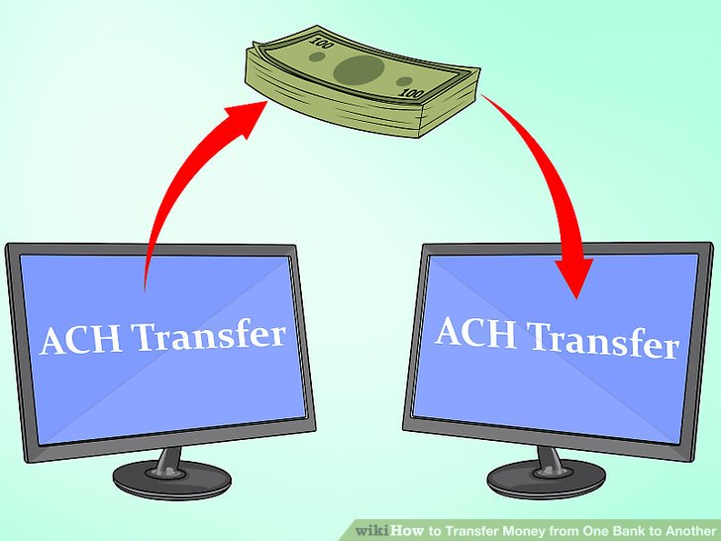
What is an Apex transaction?
An Apex transaction represents a set of operations that are executed as a single unit.
All the DML operations in a transaction either complete successfully, or if an error occurs even in saving a single record, then the entire transaction is rolled back.

